Slide 1
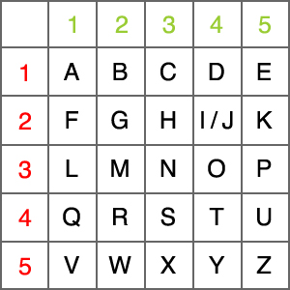
Origins of Encryption
Many term the beginnings of encryption as with the Egyptians
Using unusual hieroglyphics rather than normal ones.
Purpose of code was to add a sense of dignity and authority.
Evolved into using an entirely different hieroglyphics system.
Polybius Square
Notes:
In Menet Khufu, completed by a master scribe – 1900BC

Slide 2
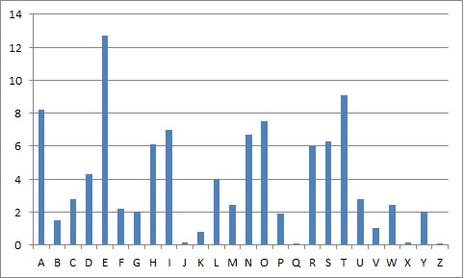
Caesar Cipher
A specific shift (3) of a substitution cipher used famously by Julius Caesar, however used for over 300 years afterwards, through much of the Roman Empire – actually first used by Hebrew Scholars
The weakness was only published 800 years later, by the Arab mathematician Al-Kindi (also created polyalphabetic ciphers)
Frequency Analysis
Polyalphabetic Ciphers
Using a shift word – flattens the frequency distribution graph
Solved by using repeated strings – allows you to find the length of the shift word, therefore you can do a frequency analysis on every nth character, thus finding the shift word.
Investigated by a number of famous mathematicians throughout history
Al-Kindi – 800AD, Charles Babbage, Blaise de Viginere

Slide 3
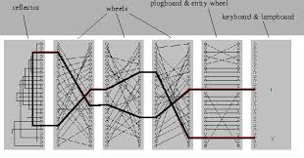
WW1 Ciphers
All based off the polyalphabetic ciphers
Quite easily broken – apparently the French Cryptographers broke the Russian code in under 10 minutes
Thus not relied upon
Conscious effort after this to improve codes
One Time Pad
WW2 Ciphers
Enigma
Caesar Cipher | 26
One Time Pad | 26^{n} (where n is the word to encrypt)

Slide 4
Public Key Cryptography
People needed to share a key (One Time Pad)
Diffie-Helman Key Exchange (still used today)
Makes use of modular arithmetic
Generator^{x} mod y = z
Vary x
Y is a high prime
Z is equally likely to be between 0 and y-1
Discrete Logarithm Problem – must be solved using trial and error
EXAMPLE
Flaws
Man-in-the-middle hack

Slide 5
References
Crypto.interactive-maths.com, (2015). [online] Available at: http://crypto.interactive-maths.com/uploads/1/1/3/4/11345755/5749995_orig.jpg [Accessed 19 Nov. 2015].
Geocache360.com, (2015). [online] Available at: http://geocache360.com/wp-content/uploads/2013/02/polybius.jpg [Accessed 19 Nov. 2015].
Mlb.co.jp, (2015). [online] Available at: http://www.mlb.co.jp/linux/science/genigma/enigma-referat/img7.png [Accessed 19 Nov. 2015].

